Slide 1
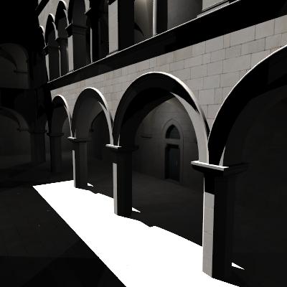
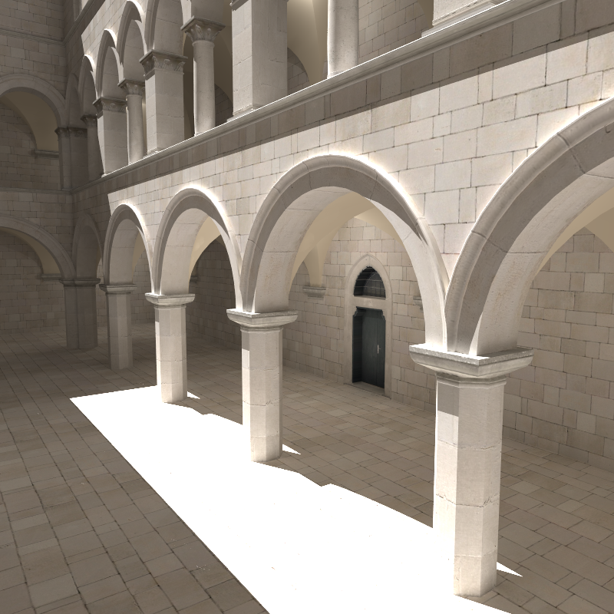
Selected Topics in Global Illumination Computation
Jaroslav Křivánek
Charles University, Prague
Jaroslav.Krivanek@mff.cuni.cz

Slide 2
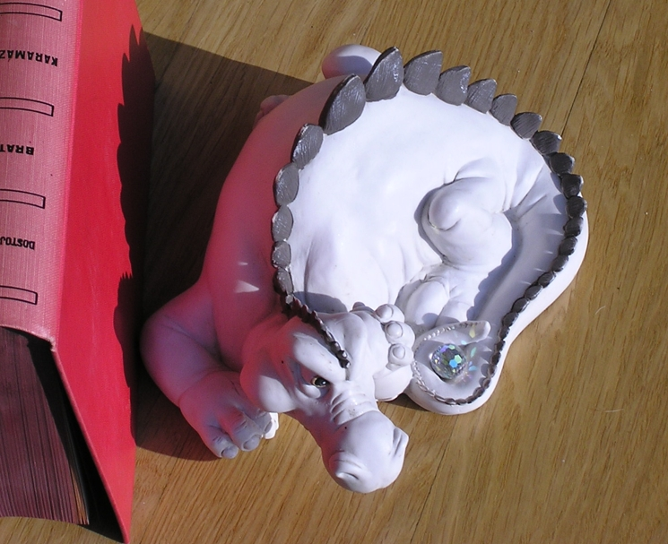
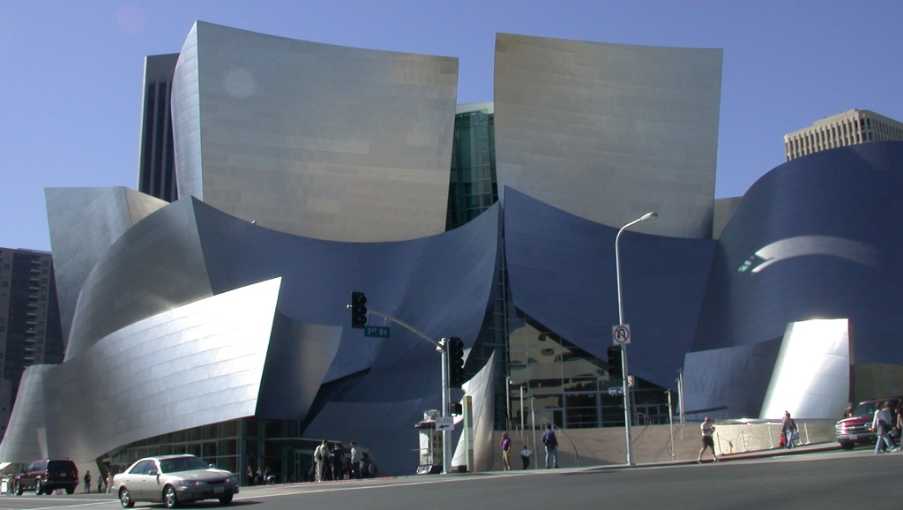
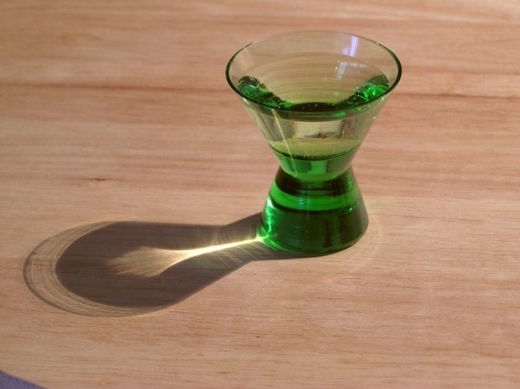

Global illumination
Light bouncing around in a scene
glossy reflections
diffuse inter-reflections
caustics
refractions
www.photos-of-the-year.com
Notes:
This talk is about global illumination (GI), which, in the layman’s terms, is due to light bouncing around in a scene. Depending on objects’ shapes and materials, GI can give rise to all sorts of visual effects some of which are shown here.

Slide 3
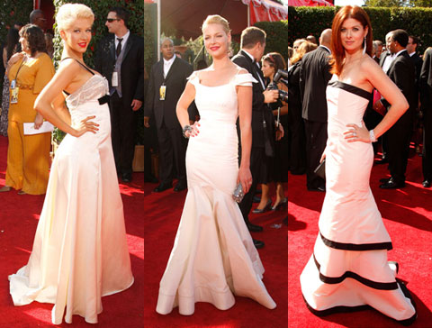
Diffuse inter-reflection
May go unnoticed, but looks odd if missing
Slide credit: Michael Bunnell
3
Notes:
A less contrived example of global illumination, due to Michael Bunnell, is shown here. The diffuse inter-reflections provide subtle details in illumination that may often go unnoticed, but without which the image would look strange: smooth illumination gradients, colors in shadows, and color-bleeding.

Slide 4
Why is GI important?
Architectural visualization
Interior design
Product design
Animated movies, special effects
Games
Quality criteria depend on the application
Notes:
Why is GI important? Essentially any application that uses CG rendering also uses global illumination.

Slide 5
Syllabus discussion

Slide 6
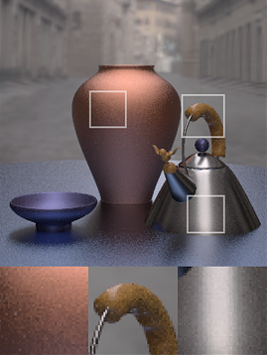
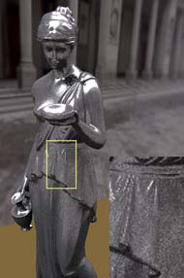
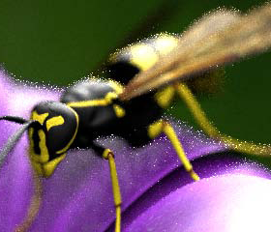
Data-driven importance sampling
Direct illumination
sampling
Sampling various
illumination effects
Measured BRDF sampling
[Lawrence et al. 2004]
[Wang & Åkerlund 2009]
[Cline et al. 2008]

Slide 7
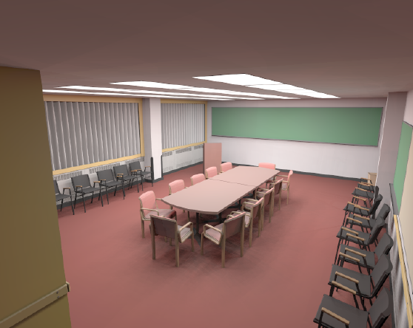
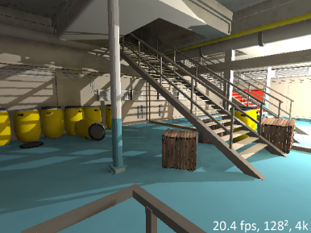
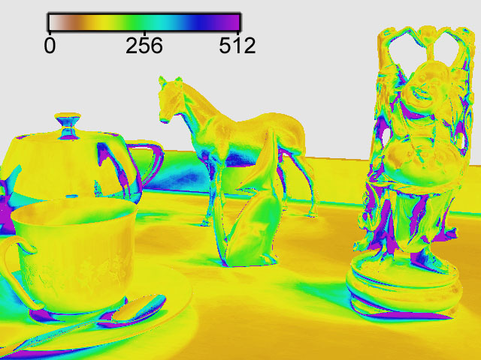
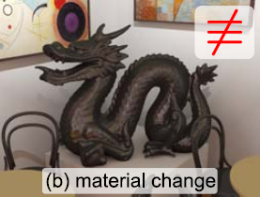
Many-light rendering methods
Basic formulation (VPLs)
Speeding it up: Real-time methods
[Keller 1997]
[Ritschel et al. 2008]
Making it scalable
Making it robust
[Walter et al. 2005]
[Křivánek et al. 2010]

Slide 8
Real-time GI for Games & Other Apps
No-precomputation
  Real-time many-light methods
  Other stuff
Precomputed radiance transfer (PRT)
  Light transport as a linear operator
  Spherical harmonics PRT
  Wavelet PRT
  Separable BRDF approximation
  Direct-to-Indirect Transfer
  Non-linear operator approximations

Slide 9
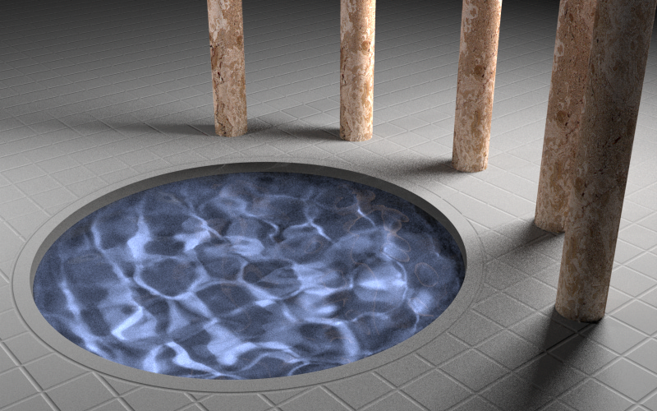
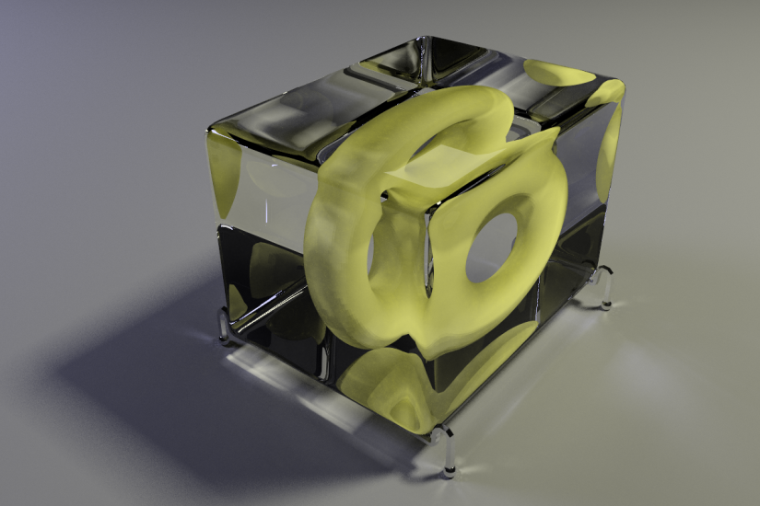
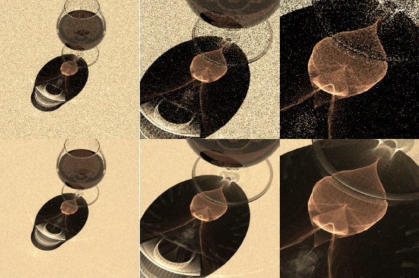
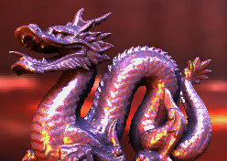
Metropolis sampling & apps
Metropolis light transport
Energy redistribution path tracing
[Veach & Guibas, 1997]
[Cline et al. 2005]
Metropolis photon tracing
Metropolis env. map sampling
[Hachisuka & Jensen 2011]
[Ghosh & Heindrich 2006]

Slide 10
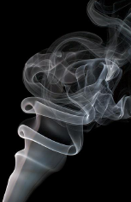
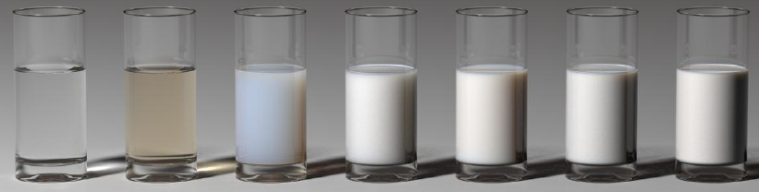
Participating media
Radiative transport equation
Single scattering solutions
Multiple scattering solutions
  Volumetric (bidirectional) path tracing
  Volumetric photon mapping
  Volumetric radiance caching

Slide 11
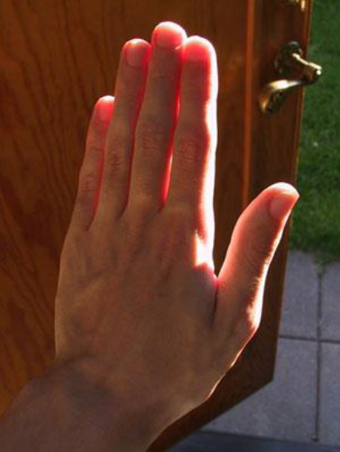
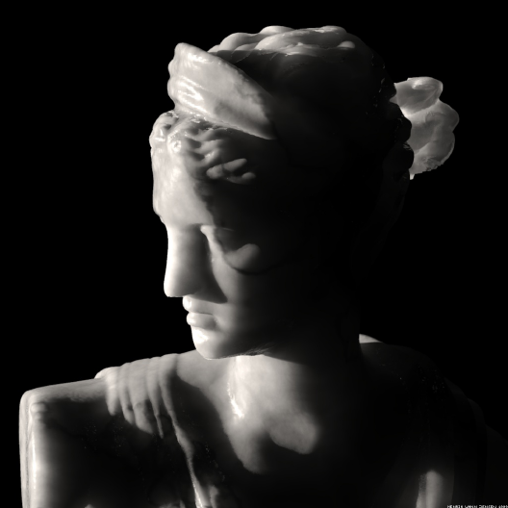
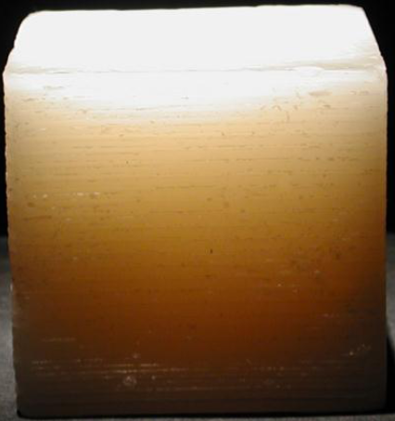
Subsurface scattering
Diffusion approximation
BSSRDF
Fast hierarchical computation
Multi-layered materials
Real-time solutions

Slide 12
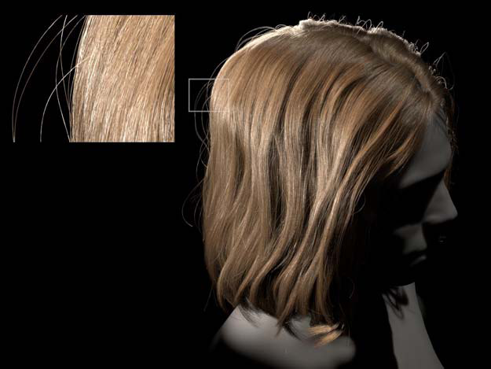
Appearance modeling
Surface BRDF models
Hair
  Kajiya-Kay, Marschner reflection model
  Multiple scattering in hair
Measurement & data-driven models
[d’Eon et al. 2011]

Slide 13
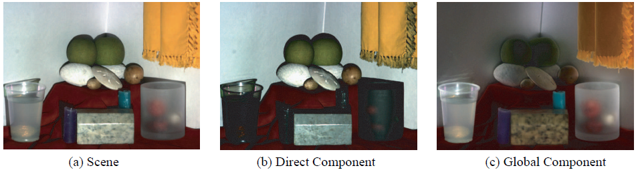
A little more exotic stuff
Light transport measurement
  Nystrom kernel method
  Compressed sensing
  Separation of direct and indirect illumination
Fabrication
  Reflectance fabrication
  Volumetric scattering fabrication
[Nayar et al. 2006]

Slide 14
Rules & Organization

Slide 15
Student participation
Either
  Lecture notes
    Prepare notes based on lectures given in the class
  Give a 45-minute lecture
    Topic chosen by the student
    Must be closely related to the class
Or
  Research / Implementation
    Topic chosen by the student or assigned by the instructor
    Preferably (but not necessarily) original, unpublished work

Slide 16
Student evaluation
Student participation
Oral exam
  2 questions from the lecture material
  1 out of 3 papers (must be different from the lecture material)

Slide 17
Books & other sources
M. Pharr, G. Humphreys: Physically-based rendering. Morgan-Kaufmann 2004 (2nd ed. 2010)
Dutre, Bala, Bekaert: Advanced Global Illumination. AK Peters, 2006.
Szirmay-Kalos: Monte-Carlo Methods in Global Illumination, Vienna University of Technology, 2000. http://sirkan.iit.bme.hu/~szirmay/script.pdf
Paper references on the class page: http://cgg.mff.cuni.cz/~jaroslav/teaching/2012-npgr031/index.html

Slide 18
A brief review of physically-based rendering

Slide 19
Required knowledge
Radiometry / light reflection (BRDF)
Rendering equation
Monte Carlo quadrature
  Primary estimator, Importance sampling, Stratified sampling, Multiple-importance sampling
Path / light tracing
Bidirectional path tracing
(Progressive) photon mapping
Irradiance caching

Slide 20

Rendering
For each visible point p in the scene
  How much light is reflected towards the camera
How much light?
20
Notes:
Let us now briefly review some basic terms of GI computation. Given the description of a scene, the goal of realistic rendering is to compute the amount of light reflected from visible scene surfaces that arrives to the virtual camera through image pixels. This light determines the color of image pixels.

Slide 21
Radiance
“Amount of light” transported by a ray
  To / from point p
  To / from direction ω
L (p, ω) [W / m² sr ]
Constant along a ray
Proportional to
perceived brightness
N
ω
dω
θ
p
dA

Slide 22
Direct vs. indirect illumination
Where does the light come from?
  Light sources (direct illumination)
  Scene surfaces (indirect illumination)
direct
indirect
indirect
p
22
Notes:
Focusing on one such point, where does the light come from? Surely, it comes directly from the light sources placed in the scene – this is called the direct illumination. But light can also arrive from any scene surface, after being reflected several times. This is the indirect illumination.

Slide 23
Where does the light go then?
Light reflection – material reflectance
p
23
Notes:
Now we know where the light comes from at p. But we want to compute how much of it is reflected towards the camera. This is determined by the surface material reflectance properties.

Slide 24
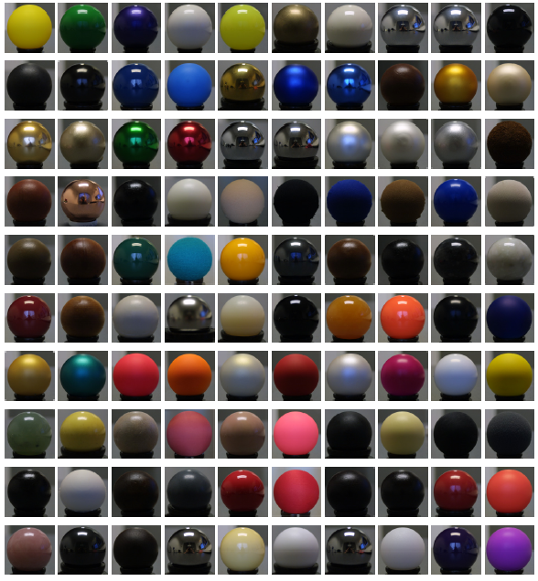
Light reflection
BRDF
  Bi-directional
  Reflectance Distribution
  Function
Implementation:
  Shader
Image courtesy Wojciech Matusik
24
Notes:
The material reflectance determines the surface’s response to incoming light. The spheres on the right are all illuminated the same – their varying appearance is entirely determined by their different material properties. In physically-based image synthesis (rendering), the most common way to mathematically describe material reflectance characteristics is the BRDF – bidirectional reflectance distribution function.

Slide 25
Light reflection – BRDF
Bi-directional Reflectance Distribution Function
ω_{i}
p
25
Notes:
Now we know where the light comes from at p. But we want to compute how much of it is reflected towards the camera. This is determined by the surface material reflectance properties.

Slide 26
BRDF components
Glossy / specular
Diffuse
26
Images by Addy Ngan

Slide 27
Local reflection integral
Total amount of light reflected to ω_{o}:
L_{o} (ω_{o}) = L_{e} (ω_{o}) + ∫ L_{i}(ω_{i}) BRDF (ω_{i}, ω_{o}) cosθ_{i} dω_{i}
L_{o} (ω_{o})
L_{i}(ω_{i})
p
27
Notes:
We want to compute the amount of light going from p towards the camera. Assuming we know how much light is coming to p from all possible directions (the incoming hemisphere), the reflected light can be computed by evaluating the illumination integral: For each incoming direction, we multiply the radiance from that direction by the BRDF and the cosine term. To get the total amount of reflected light, we sum (integrate) these contributions over all incoming directions. Then we add the self emitted light at p (in case p is on the light source) and we have the total amount of light going from p towards the camera.

Slide 28
Light transport
Q: How much light is coming from ω_{i} ?
A: Radiance constant along rays, so:
L_{i}(p,ω_{i}) = L_{o}(p’,−ω_{i})
= L_{o}(r(p,ω_{i}),−ω_{i})
ray casting
function
L_{o}(p’,−ω_{i})
p’
=
L_{i}(p,ω_{i})
p
28
Notes:
We made an important assumption in computing the illumination integral. We assumed that we know how much light is coming to p from each direction. But how do we find this out? Taking advantage of the fact that radiance does not change along straight lines, we see that the incoming radiance from direction w_{i} is equal to the outgoing radiance at a point p’ visible from p along w_{i}.

Slide 29
Rendering equation
L_{o} (p, ω_{o}) = L_{e} (ω_{o}) + ∫ L_{i}(p, ω_{i}) BRDF (p, ω_{i}, ω_{o}) cosθ_{i} dω_{i}
L_{o} (p, ω_{o}) = L_{e} (ω_{o}) + ∫ L_{o}(r(p,ω_{i}),−ω_{i}) BRDF (p, ω_{i}, ω_{o}) cosθ_{i} dω_{i}
L_{o}(p’,−ω_{i})
p’
=
L_{i}(p,ω_{i})
p
29
Notes:
We made an important assumption in computing the illumination integral. We assumed that we know how much light is coming to p from each direction. But how do we find this out? Taking advantage of the fact that radiance does not change along straight lines, we see that the incoming radiance from direction w_{i} is equal to the outgoing radiance at a point p’ visible from p along w_{i}.

Slide 30
Rendering eqn vs. reflection integral
Reflection Integral
  Local light reflection
  Integral to compute L_{o} given that we know L_{i}
Rendering Equation
  Condition on light distribution in the scene
  Integral equation – the unknown, L, on both sides

Slide 31
Solving RE – Recursion
L_{o} (p, ω_{o}) = L_{e} (ω_{o}) + ∫ L_{o}(r(p,ω_{i}),−ω_{i}) BRDF (p, ω_{i}, ω_{o}) cosθ_{i} dω_{i}
Q: How much light is reflected from p’ ?
Recursive application of RE at p’
Recursive nature of
light transport
L_{o}(p’,−ω_{i}) = ?
p’
p
31
Notes:
We have transformed the question of “how much light is coming to p from some direction” into “how much light is leaving p’ into the opposite direction”. To answer the latter question, we apply the illumination integral once again at p’, in a recursive fashion. We can see that light transport is a recursive procedure, where each recursion level corresponds to one reflection of light.

Slide 32
Solving RE – Recursion
Recursive evaluation of illumination integral at different points (p, p’, … )
p’
p
32
Notes:
We have transformed the question of “how much light is coming to p from some direction” into “how much light is leaving p’ into the opposite direction”. To answer the latter question, we apply the illumination integral once again at p’, in a recursive fashion. We can see that light transport is a recursive procedure, where each recursion level corresponds to one reflection of light.

Slide 33
Monte Carlo integration
General approach for numerical estimation of integrals
Integral to evaluate:
f(x)
Monte Carlo estimator:
p(x)
0
ξ₅
ξ₃
ξ₁
ξ₄
ξ₂
ξ₆
1

Slide 34
Monte Carlo integration
Estimator <I> gives an unbiased estimate of I:

Slide 35
Applying MC to rendering
L_{o} (p, ω_{o}) = L_{e} (ω_{o}) + ∫ L_{o}(r(p,ω_{i}),−ω_{i}) BRDF (p, ω_{i}, ω_{o}) cosθ_{i} dω_{i}
integrand f(ω_{i})
random sample →
cast a ray in a random direction
p’
p
35

Slide 36
Distribution Ray Tracing
Recursive nature – ray tracing
Direct illumination separated from indirect
p
Notes:
Although the rendering equation is at the heart of all theoretical analyses of global illumination, our solution strategy – recursive ray tracing – is much more reminiscent of the illumination integral. At each point of the scene, we want to estimate the outgoing light. In order to do this, we want to numerically evaluate the illumination integral. So we shoot secondary rays, which are ‘samples’ of the incoming radiance. These samples are then multiplied by the BRDF and averaged to numerically estimate the outgoing radiance.
For each of these secondary rays, we need to evaluated the outgoing radiance at a point where they intersect the scene. So we use the same procedure recursively again and again. The recursion can be limited since each light reflection takes away some of the transported light energy. So after couple of reflections, the contribution of light to the image becomes insignificant.

Slide 37

Distribution Ray Tracing
Cook ’84
Breakthrough at the time
Problem: Terribly slow!
  Number of rays exponential with recursion depth
Solution: Irradiance caching / path tracing / …

Slide 38
Unbiased vs. consistent estimator
Unbiased estimator
  No systematic error, only variance
Consistent estimator
  May has systematic error
  Converges to the correct result

Slide 39
Unbiased / consistent GI algorithms
Path Tracing – unbiased
Light Tracing – unbiased
Bi-directional Path Tracing – unbiased
Metropolis Light Transport – unbiased
Photon Mapping – biased, not consistent
Progressive photon mapping – biased, consistent
Irradiance caching – biased, not consistent
Radiance caching – biased, not consistent

Slide 40
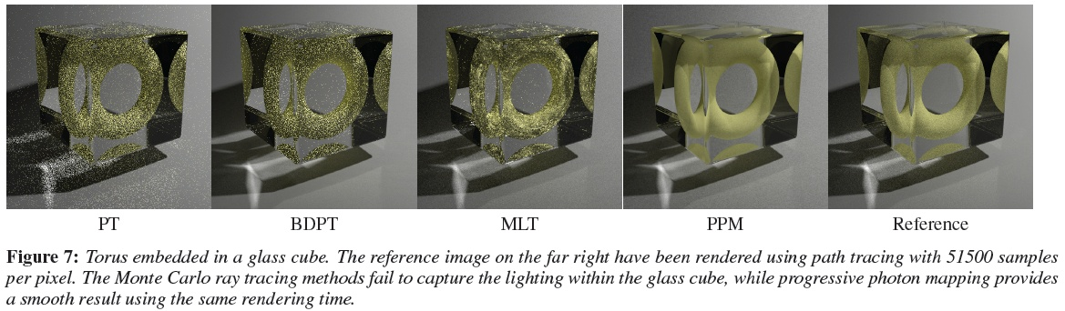
GI Algorithms: Pros and Cons
Image credit: Toshiya Hachisuka

Slide 41
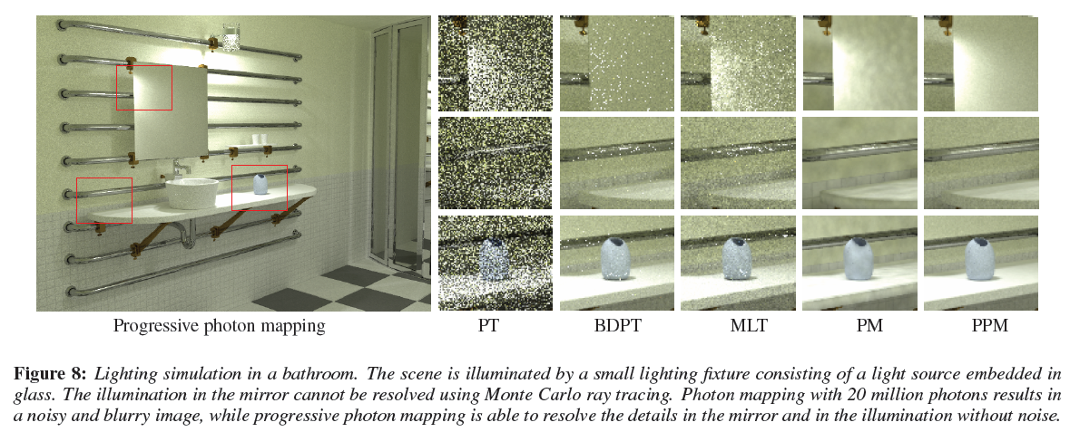
GI Algorithms: Pros and Cons
Image credit: Toshiya Hachisuka

Slide 42
Unbiased vs. consistent GI algorithm
Practice
  Prefer less noise at the cost of bias
  Systematic error is more acceptable than noise if “looks good” is our only measure of image quality

Slide 43
There’s more to realistic rendering
We’ve seen
  GI, i.e. Light transport simulation
There’s also
  Emission modeling
    How do various objects emit light?
  Appearance modeling
    What does light do after it hits a specific surface?
  Tone mapping
    Radiance remapping for display

